Slide 1




Introduction to Quiz Management System
A quiz management system is a software application that allows educators to create, manage, and administer quizzes and exams. It provides a platform for users to conduct assessments and track student performance.
by Aayush Chalke

Slide 2
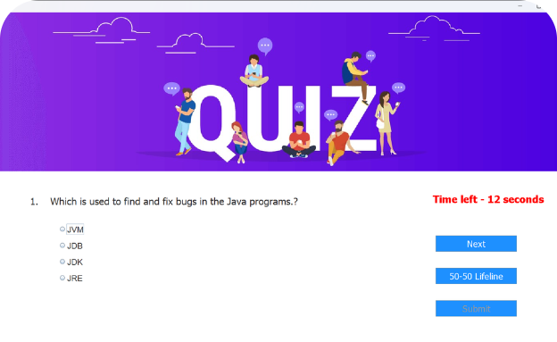
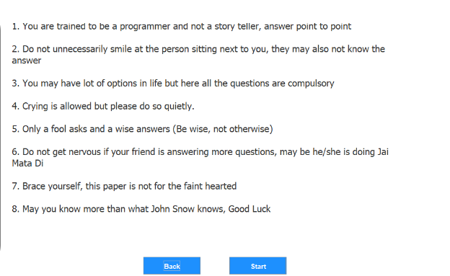
Features of the Quiz Management System
Dashboard
Question Bank
The system offers an intuitive dashboard that provides a comprehensive overview of quiz performance, user activity, and overall statistics.
A robust question bank feature facilitates the storage and organization of questions for easy retrieval and quiz creation.

Slide 3

User Interface Design using Java Swing
Customization
Event Handling
Java Swing allows for highly customizable user interfaces with a wide range of components like buttons, text fields, and windows.
It provides comprehensive event handling mechanisms that enable the development of interactive and responsive interfaces.
Rich Look and Feel
With Java Swing, designers can create visually appealing interfaces with consistent look and feel across different platforms.

Slide 4
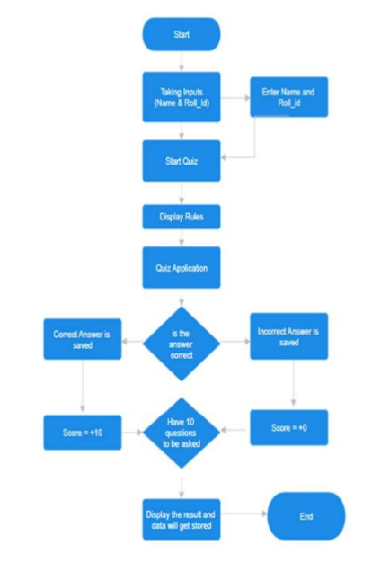

Database Design and Implementation
Data Organization
Scalability
The database is structured to efficiently organize and manage the quiz-related data, including user information, quiz content, and results.
The database is designed with scalability in mind, ensuring it can accommodate a growing number of users, quizzes, and data records.

Slide 5
Quiz Creation and Management
1
Efficient Workflow
2
Question-Level Settings
The system offers an efficient workflow for creating, editing, and organizing quizzes and their associated content.
Users have the flexibility to set various parameters at the question level, such as timers, point values, and difficulty levels.
3
Automatic Grading
4
Rich Media Support
It enables automatic grading and result generation, saving time and effort for educators.
The system supports the inclusion of rich media, including images, audio, and video, in quiz content.

Slide 6
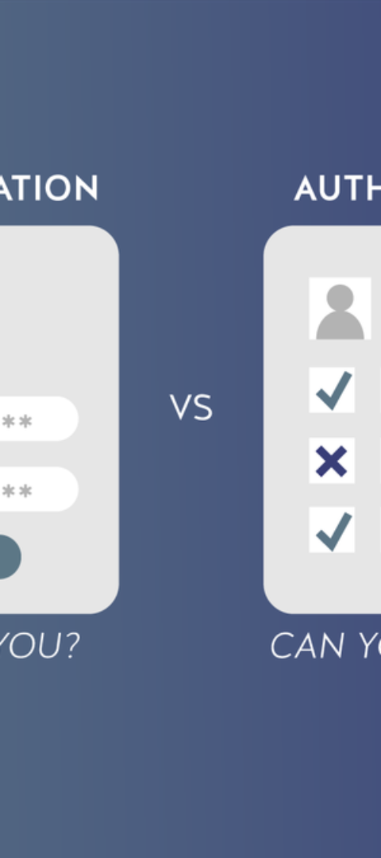
User Registration and Authentication
1
Registration Process
The system provides a streamlined user registration process, ensuring a smooth onboarding experience for users.
2
Authentication Methods
It supports multiple authentication methods, including email, social logins, and multi-factor authentication for enhanced security.
3
Profile Management
Users can manage their profiles, personalize settings, and update their information with ease.

Slide 7
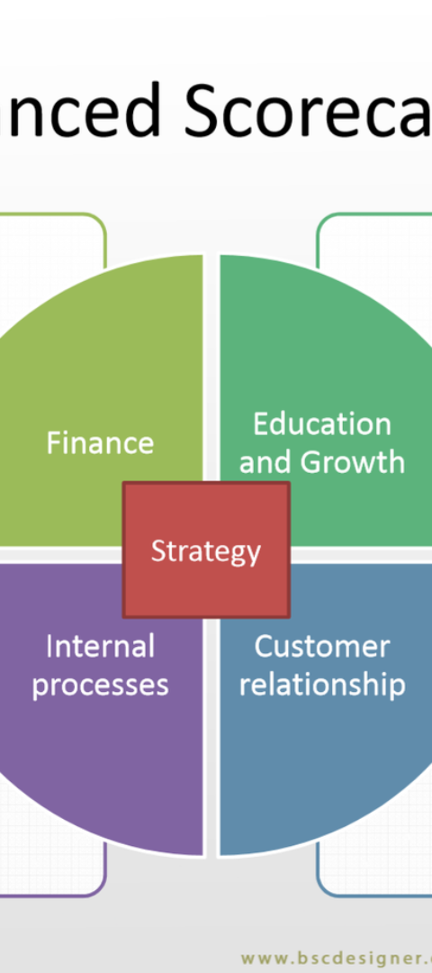



Scoring and Result Generation
Real-Time Scoring
The system provides real-time scoring and feedback, allowing both educators and students to track performance instantly.
Comprehensive Reports
It offers comprehensive reporting features, including detailed performance analysis and score breakdowns.
Customization Options
Users can customize score calculation methods, grade scales, and assessment criteria to align with their specific requirements.

Slide 8
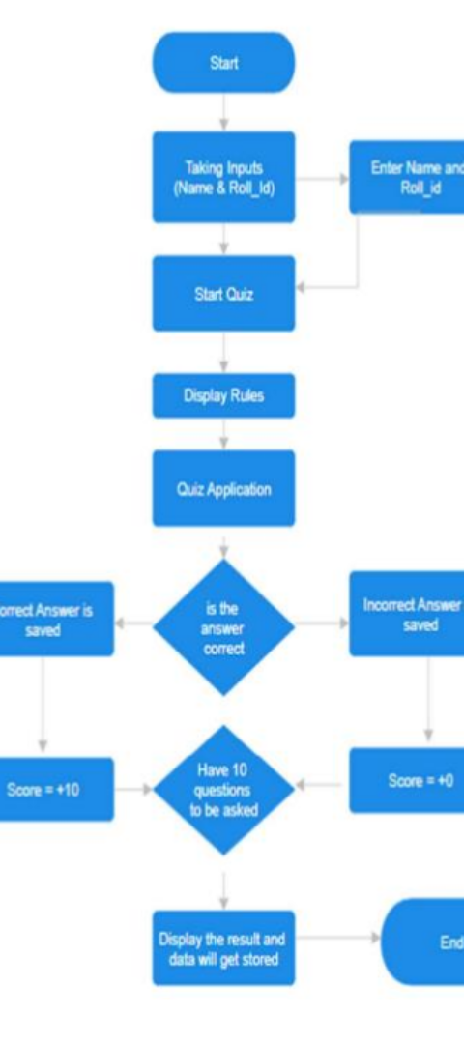
Conclusion and Future Enhancements
Continuous Improvement
Community Engagement
The system is designed to support future enhancements, including new features, integrations, and usability improvements based on user feedback and emerging technologies.
Users can engage in a community forum to share ideas, best practices, and suggestions for system enhancements and optimizations.
Scalability Plans
The system's roadmap includes scalability plans to ensure seamless performance as the user base and educational content expand.

